Slide 1
Bank Direct Marketing A Data Science Project
By: Aanchal Khanna

Slide 2
Project Overview
A marketing data science project
Objective: To build a predictive model for a bank deposit scheme
Scope: Modeled several classifiers and deployed the best performing model

Slide 3
Data Overview
Dataset: Bank Marketing Dataset of a Portuguese banking institution
Source: UCI Machine Learning Repository
[https://archive.ics.uci.edu/ml/datasets/bank+marketing]
Dataset contains client records from a previous marketing campaign
Client’s personal information
Client’s financial information
Previous interactions between the bank and that client

Slide 4
Research Questions
What are the key features that help predict whether a client will subscribe to a term deposit?
The marketing campaign was conducted using phone calls. Often the bank employees contact a customer several times to get them to subscribe to the term deposit. I want to find out the proportion of successful calls?
Does a client’s educational status and job type have an impact on his or her decision-making?

Slide 5
Data Science Stages

Slide 6
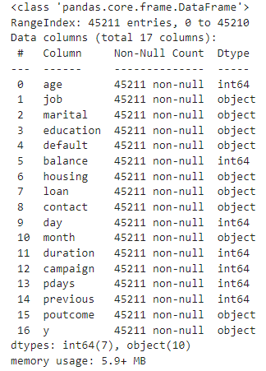
Exploratory Data Analysis
Total 10 variables had “object” data type
Features = 9
Encoding a challenge – Increased dimensionality
Feature “job” = 12 unique categories

Slide 7
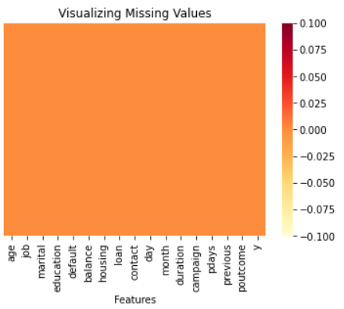
Exploratory Data Analysis
No null values, but lots of Unknown and Encoded values!
“pdays” = Null values encoded as -1.
"education", "contact", "job", & "poutcome" = Null values encoded as Unknown

Slide 8
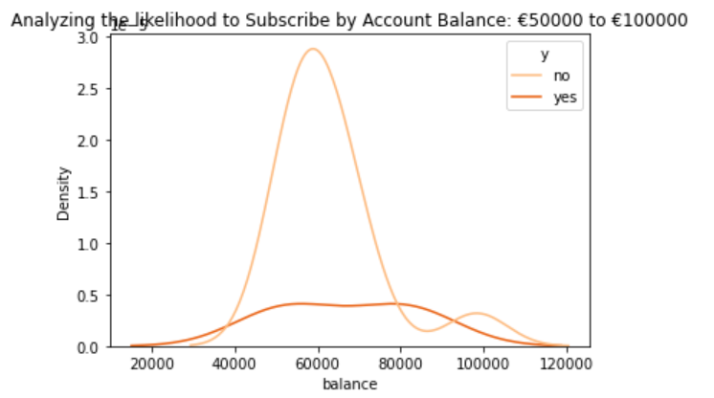
Exploratory Data Analysis
Imbalanced dataset
88% = Did not subscribe
12% = Subscribed
Did not find much pattern vis-à-vis the target
Only pattern observed in the feature “balance”
Clients with account balance between €80,000 - €90,000 had higher propensity to subscribe to the term deposit scheme

Slide 9
Data Preprocessing
Remove features
“day”
“month”
“duration”
Handle missing values
Replaced “unknown” with null values
Replaced null values with most frequent category

Slide 10
Data Preprocessing
Continuous features “pdays” & “previous”
Feature “pdays” = -1 in ~81% records
Where “pdays = -1”, “previous=0” [client not contacted previously]
Feature “pdays” = -1 replaced with 0
Scaled continuous features
Encoded categorical features
Features → OneHotEncoder()
Target → LabelEncoder()
“No” = 0
“Yes” = 1

Slide 11
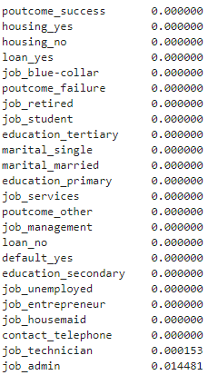
Answers to Research Questions
Key Features:
Categorical Features
P-value < 0.05
Continuous Features
Domain expertise required!!

Slide 12

Answers to Research Questions
Proportion of successful calls
Average number of successful calls = No valid variable!

Slide 13
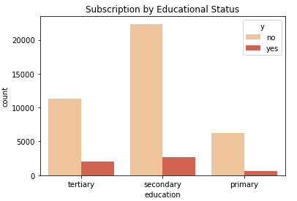
Answers to Research Questions
Educational status of candidates who subscribed
Primary Education → KG to Grade 7
Secondary Education → Grade 8-12
Tertiary Education → Universities, Colleges, Vocational Schools

Slide 14
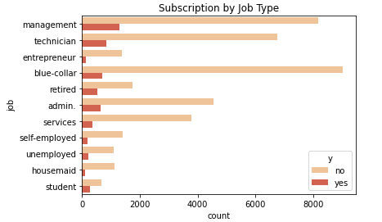
Answers to Research Questions
Job type of candidates who subscribed

Slide 15

Balanced Dataset
Create a balanced dataset using the RandomOverSampler() class
Each output category constitutes 50% of the records

Slide 16
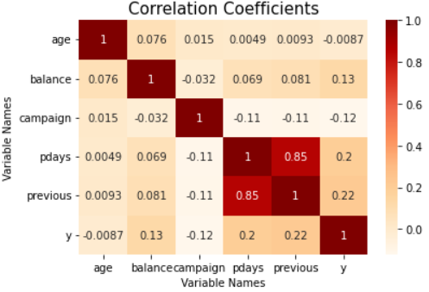
Feature Selection
Continuous features
Correlation between “pdays” & “previous” = 0.85 [Multicollinearity]
Removed “pdays”

Slide 17
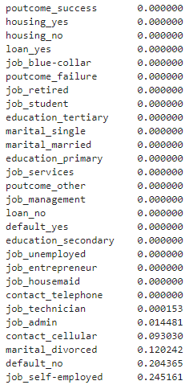
Feature Selection
Categorical features
Chi-Square test of statistical significance
Removed categorical features with p-value > 0.05
Categorical features with p-value < 0.05 → Statistically significant relationship between features and target

Slide 18
Model Training
Split into Train and Test Data
Test data = 30%
Classifiers trained
Naïve Bayes
Logistic Regression
K-Nearest Neighbors
Random Forests
XGBoost

Slide 19
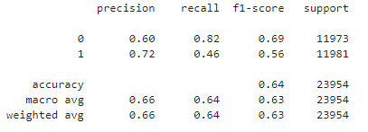
Model Training
Naïve Bayes Model
Class of interest = 1 (subscribed)
Precision → Out of all “predicted” positives (TP + FP), 72% records were correctly captured by the model (original Positives).
Recall → Out of all “original positives” (TP + FN, regardless of predicted values), 46% records correctly predicted by the model (original Positives).
Naïve = Features not independent!!

Slide 20
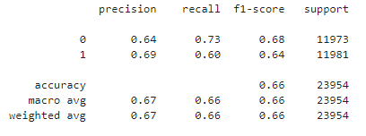
Model Training
Logistic Regression Model
Class of interest = 1 (subscribed)
Precision → Out of all “predicted” positives (TP + FP), 69% records were correctly captured by the model (original Positives).
Recall → Out of all “original positives” (TP + FN, regardless of predicted values), 60% records correctly predicted by the model (original Positives).

Slide 21
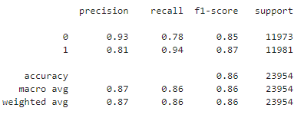
Model Training
K-Nearest Neighbors Model
Number of neighbors = 4
Class of interest = 1 (subscribed)
Precision → Out of all “predicted” positives (TP + FP), 81% records were correctly captured by the model (original Positives).
Recall → Out of all “original positives” (TP + FN, regardless of predicted values), 94% records correctly predicted by the model (original Positives).

Slide 22
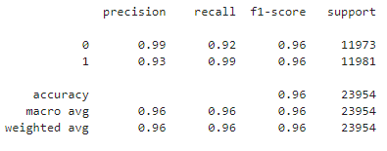
Model Training
Random Forest Model
Number of trees = 10
Class of interest = 1 (subscribed)
Precision → Out of all “predicted” positives (TP + FP), 93% records were correctly captured by the model (original Positives).
Recall → Out of all “original positives” (TP + FN, regardless of predicted values), 99% records correctly predicted by the model (original Positives).

Slide 23
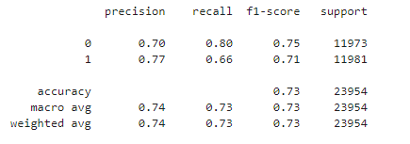
Model Training
XGBoost Model
Number of estimators = 300
Class of interest = 1 (subscribed)
Precision → Out of all “predicted” positives (TP + FP), 77% records were correctly captured by the model (original Positives).
Recall → Out of all “original positives” (TP + FN, regardless of predicted values), 66% records correctly predicted by the model (original Positives).

Slide 24
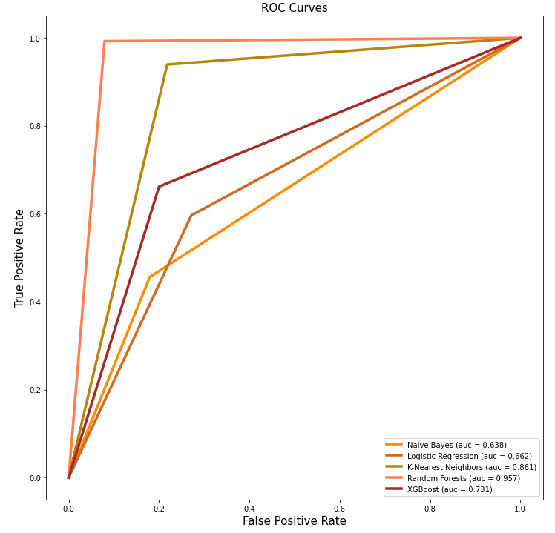
Model Selection
Area Under the Curve (AUC)
Naïve Bayes = 0.638
Logistic Regression = 0.662
KNN = 0.861
Random Forest = 0.957
XGBoost = 0.731
Precision/Recall
KNN: Precision = 81%, Recall = 94%
Random Forest: Precision = 93%, Recall = 99%
Other considerations
Random Forest = overfitting; KNN = high training time

Slide 25
Model Deployment
Deployed KNN model (number of neighbors = 4) with AWS SageMaker

Slide 26
Future Considerations
Domain knowledge and research questions
Business relevant insights
Perform EDA with balanced dataset
Majority of EDA is performed using the imbalanced dataset
Perform EDA with the balanced dataset that was created using RandomOverSampler() class
Iterations: Play around with different features to see how their inclusion/exclusion impacts model performance
Exclude the feature “balance” and see how it impacts the models
Perform two iterations, one where the feature “pdays” is removed and the other where the feature “previous” is removed.
Iterations: Perform hyperparameter tuning to see how different parameters impact model performance
Performing hyperparameter tuning, especially for the XGBoost model
Deploy the chosen model (KNN) into Cloud using AWS SageMaker
Create an application where end-user can enter the values for different features on a UI and get the predicted output

Slide 27
Thank You…

